Slide 1
Sensors Used in Project

Slide 2
Overview:
Sensors Descriptions.
Need for that sensors.
Pinout of the sensors.
Interfacing the sensors with arduino individually and simultaneously.
Verifying the sensor values with the accuracy against the datasheet.

Slide 3
Sensors used in the project
( For Agricultural Application ) :
Atmosphere Temperature Sensor.
Atmosphere Humidity Sensor.
Soil Temperature Sensor.
Soil Moisture Sensor.
Water Turbidity Sensor.

Slide 4
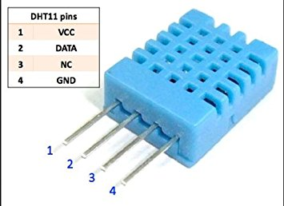
Air Temperature + Humidity Sensor
{Model : DHT-11, Source: Datasheet}
Need: The Plant growth depends on the temperature and humidity of the air surrounding it.
Low cost
3 to 5V power and I/O
2.5mA max current use during conversion (while requesting data)
Good for 20-80% humidity readings with 5% accuracy
Good for 0-50°C temperature readings ±2°C accuracy
No more than 1 Hz sampling rate (once every second)
Body size 15.5mm x 12mm x 5.5mm
4 pins with 0.1" spacing

Slide 5
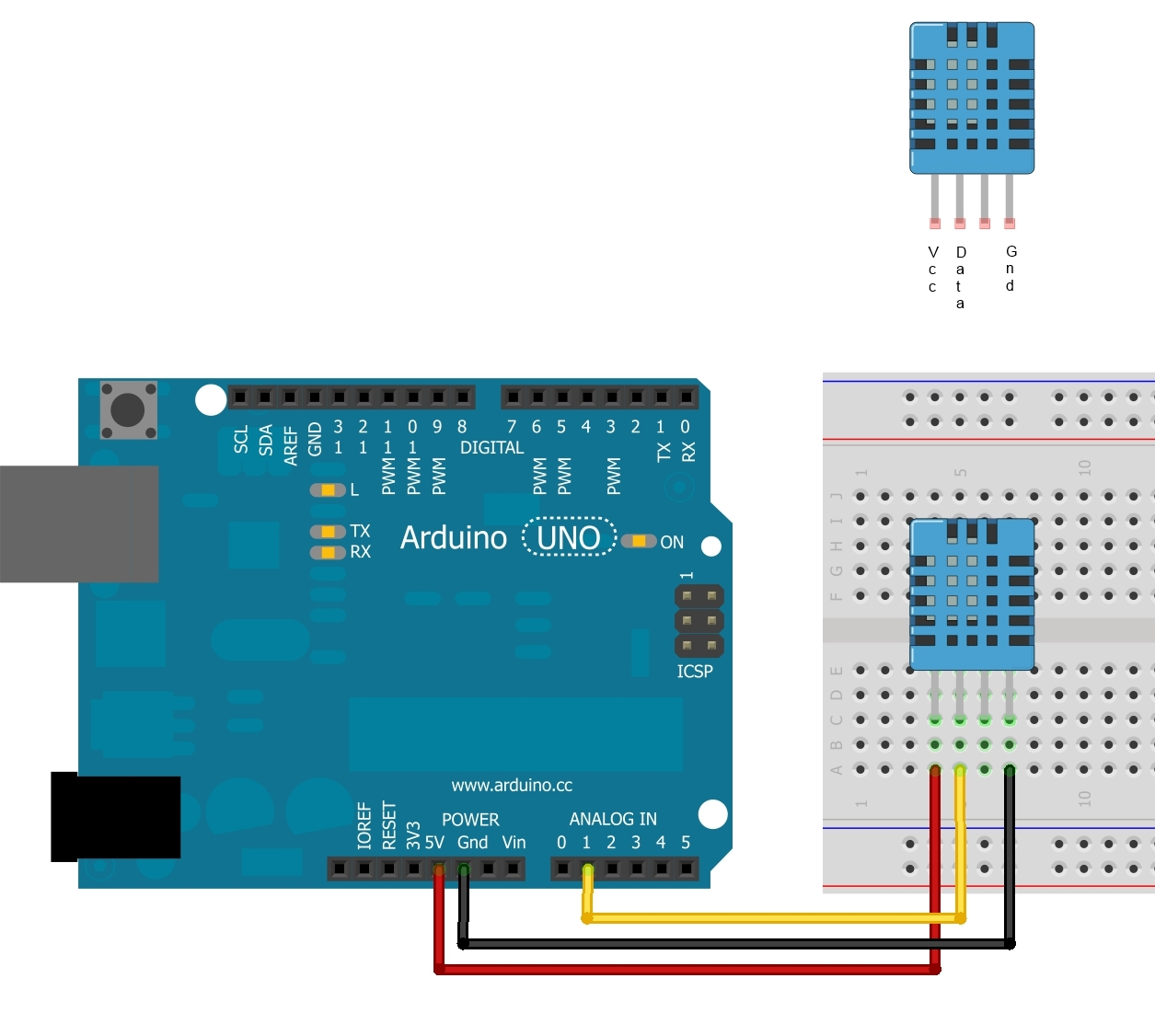
Schematic of DHT-11 with Arduino UNO:

Slide 6
Code and Arduino Library Used: Source
#include <dht.h> // Importing the library of DHT into the sketch
dht DHT; // Instantiating the object
#define DHT11_PIN 7; //Giving the initial pin of the sensor to Arduino
void setup(){ Serial.begin(9600); } //Started the setup only executed once.baud = 9600
void loop() //Infinite loop for printing the sensor values onto the serial monitor
{
int chk = DHT.read11(DHT11_PIN);
Serial.print("Temperature = ");
Serial.println(DHT.temperature);
Serial.print("Humidity = ");
Serial.println(DHT.humidity);
delay(1000);
}

Slide 7
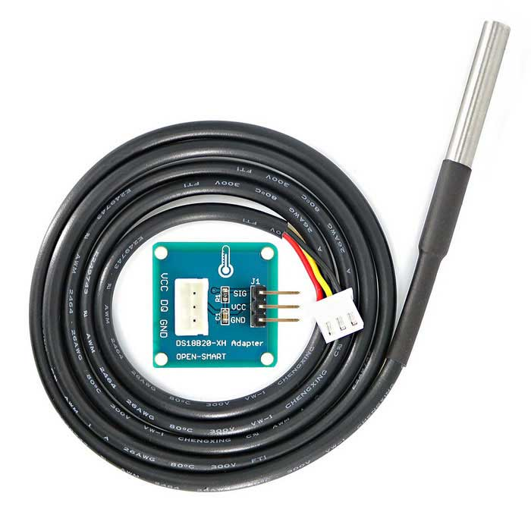
Soil Temperature Sensor DS18B20
{Datasheet Source}
3.0-5.5V input voltage
Waterproof
-55°C to+125°C temperature range
±0.5°C accuracy from -10°C to +85°C
1 Wire interface
Probe is 7mm in diameter and roughly 26mm long. Overall length (including wire) is 6 feet.
Programmable Resolution 1-Wire® Digital Thermometer

Slide 8
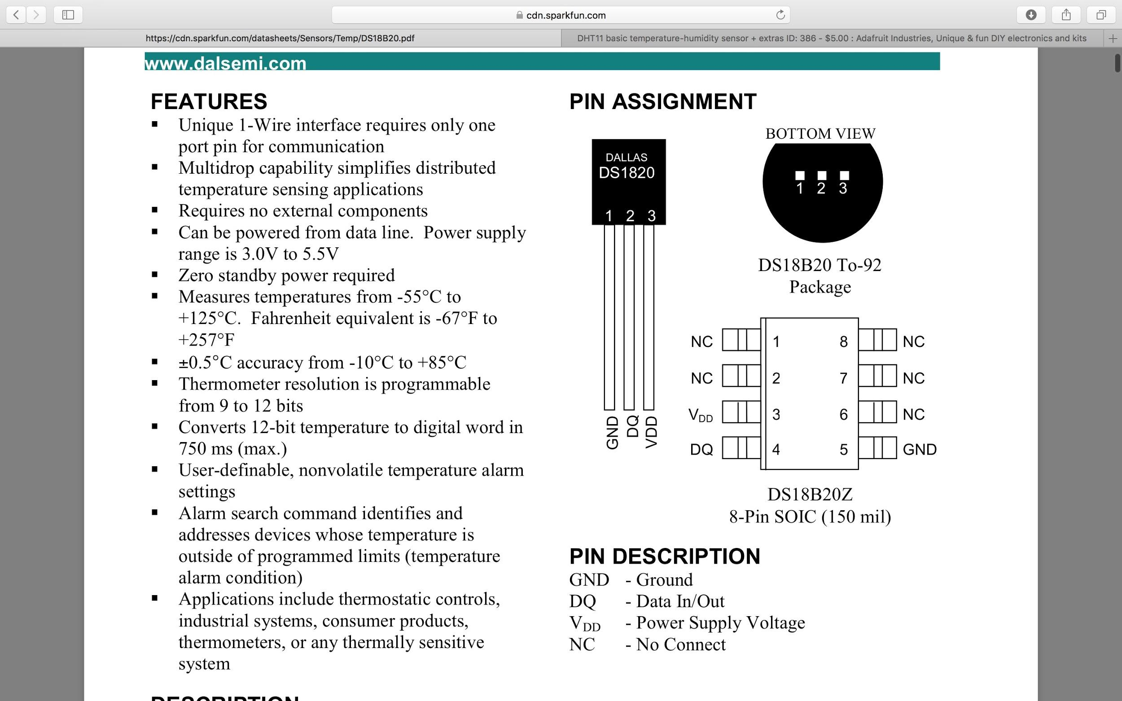

Slide 9
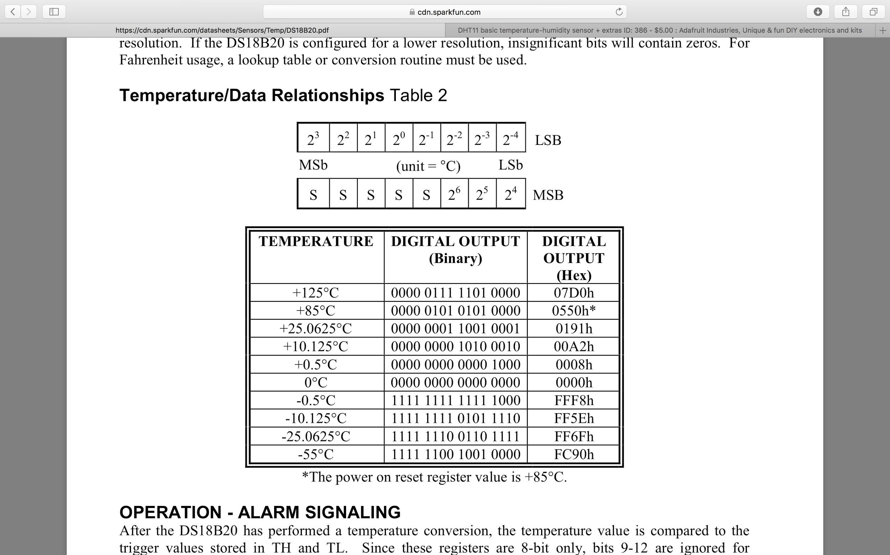
Resolution and Data Retrieval:
Temperature / Data Relationship Table

Slide 10
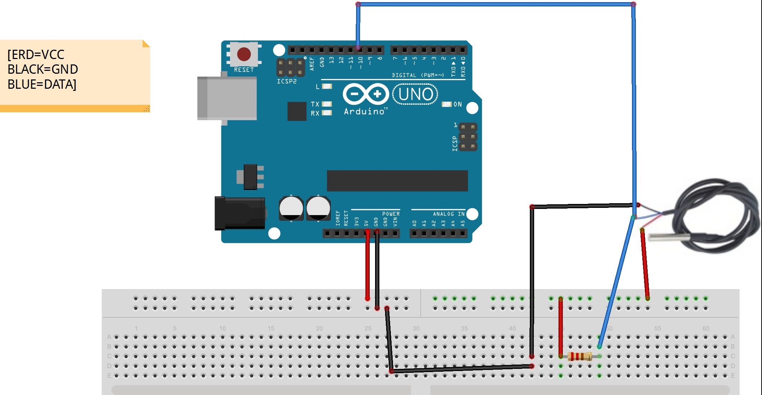
Schematic of DS18B20 with Arduino UNO:

Slide 11
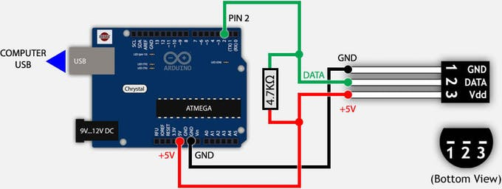
Code and Library Used: DS18B20, OneWire
#include <OneWire.h> // First we include the libraries
#include <DallasTemperature.h>
#define ONE_WIRE_BUS 2; //2nd pin is used to sensor.
OneWire oneWire(ONE_WIRE_BUS);
DallasTemperature sensors(&oneWire);
void setup(void) { Serial.begin(9600); sensors.begin(); }
void loop(void)
{
sensors.requestTemperatures();
Serial.print("Temperature is: ");
Serial.print(sensors.getTempCByIndex(0));
delay(1000);
}

Slide 12
Thank You

